Slide 1
Tracking anti-drug program and reagent milestones in Smartsheet

Slide 2
New ngs-hybridoma workflow for anti-drug development
Primary Screening
Banking Primary Hybridoma
FACS Single-Cell Subcloning
96-well Ag+ Screening
VH&VL sequence info
Confirmation of clone properties using subclone supernatants
Selection of clones for mIgG Conversion
Cell Pellet Sequencing
CHO cloning
mIgG production & purification
Data from primary screening
Assay development screening in PK and ADA assays

Slide 3
anti-drug selection process
Processes of NGS-Hybridoma Workflow:
Primary Screening: Screening of potential antidrug monoclonal antibodies
Subcloning: 20-40 hybridoma clones are selected to bank. Around 12-15 clones are then single cell sorted using fluorescence-activated cell sorting (FACS)
Sequencing: Cell pellets are sent for NGS sequencing and data is analyzed to determine clone properties. Assay development performs pharmacokinetic and antidrug antibody assays
CHO Cloning: Clones are selected for desirable mouse IgG isotype and cloned using Chinese hamster ovary (CHO)
Production: Once the antibodies are cloned in CHO, they enter production and large-scale purification
Protein Biochemistry / PMPD: Purification and scale-up of reagents
IOPS: Manufacturing a range of approved therapeutic proteins

Slide 4
Project overview
Current Process:
Each team uses their own Excel spreadsheets on SharePoint to track relevant reagents
Frequent email updates
Must search through various spreadsheets to find current status of reagents relevant to you
Updated Process (in the process of implementation):
Transitioned department-specific trackers to Smartsheet
Setup automated workflows to inform stakeholders in real time about changes relevant to them
Created a dashboard for viewing the status, milestone, and duration of all anti-drug programs
Linked all anti-drug Smartsheets into a single, easy-to-read ”master” sheet viewable on the dashboard
Future:
Use updated process to track other reagents and therapeutic leads

Slide 5
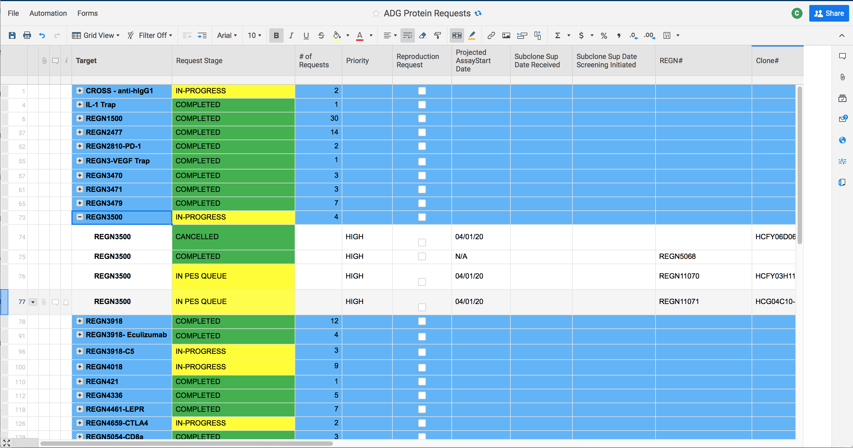
Transitioning trackers to smartsheet
5 Trackers Imported into Smartsheet:
ADG Reagent Request Tracker
IOPS Request Tracker
Anti-drug Purification List
Anti-drug Production Tracker
Drug Candidates and Fabs
Future:
PMPD reagent tracking
Production sheet for all reagents
Figure 1. Screenshot of the imported and currently in-use Assay Development Group Smartsheet

Slide 6
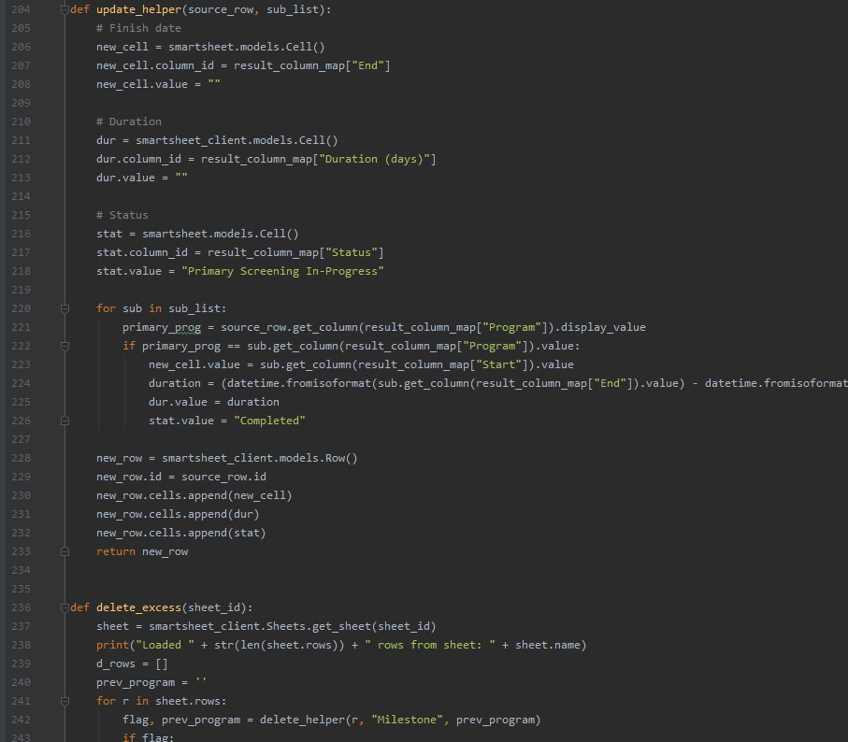
Collation of all relevant smartsheets
Problem: How to Automatically Link Sheets together?
Every sheet is formatted different with different column names
Smartsheet “Report” feature cannot cleanly combine many sheets together
Solution:
Smartsheet Application Programming Interface (API)
Smartsheet Python Software Development Kit (SDK)
Wrote a Python script (>350 lines of code) that can generate collation Smartsheets with full customizability
Easy to Use:
Download the one file + imported packages
Run on command line
Figure 2. Screenshot of a code snippet

Slide 7
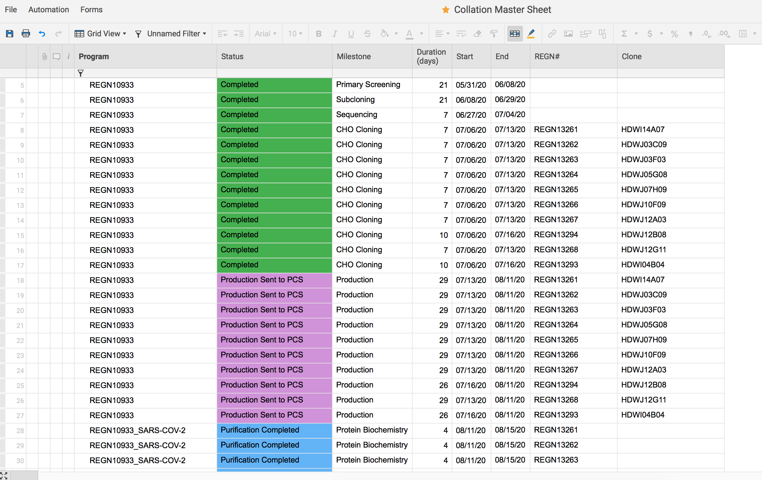
Anti-drug reagent metrics for SARS CoV-2 program
Quickly Determine Timeline with Smartsheet:
For REGN10933…
Primary Screening - 21 days
Subcloning - 21 days
Sequencing - 7 days
CHO Cloning - 7 days
Cell Line Production - 29 days
Purification - 4 days
Figure 3. Screenshot of master sheet

Slide 8
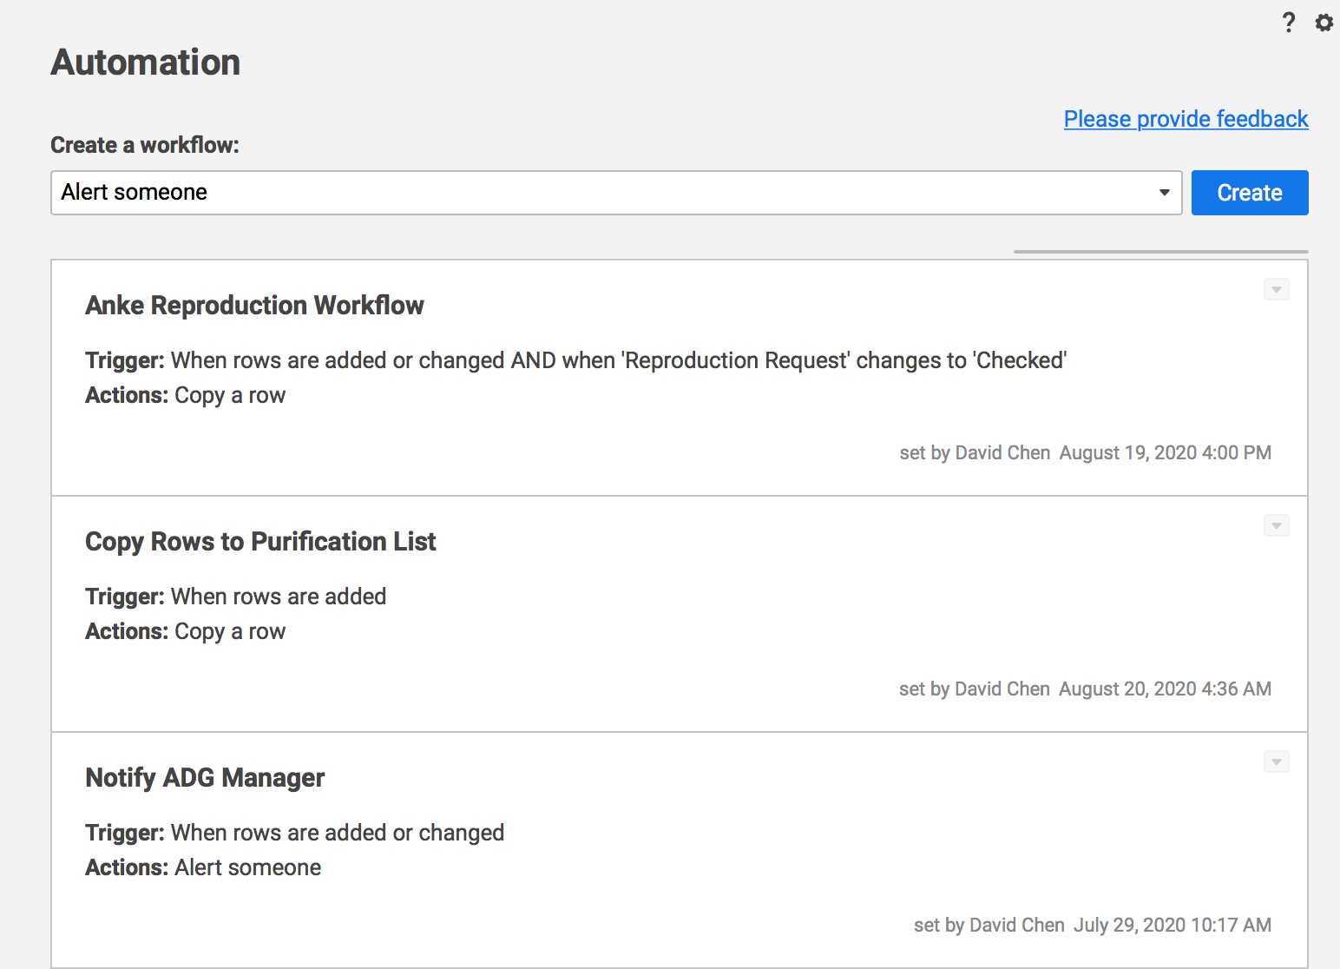
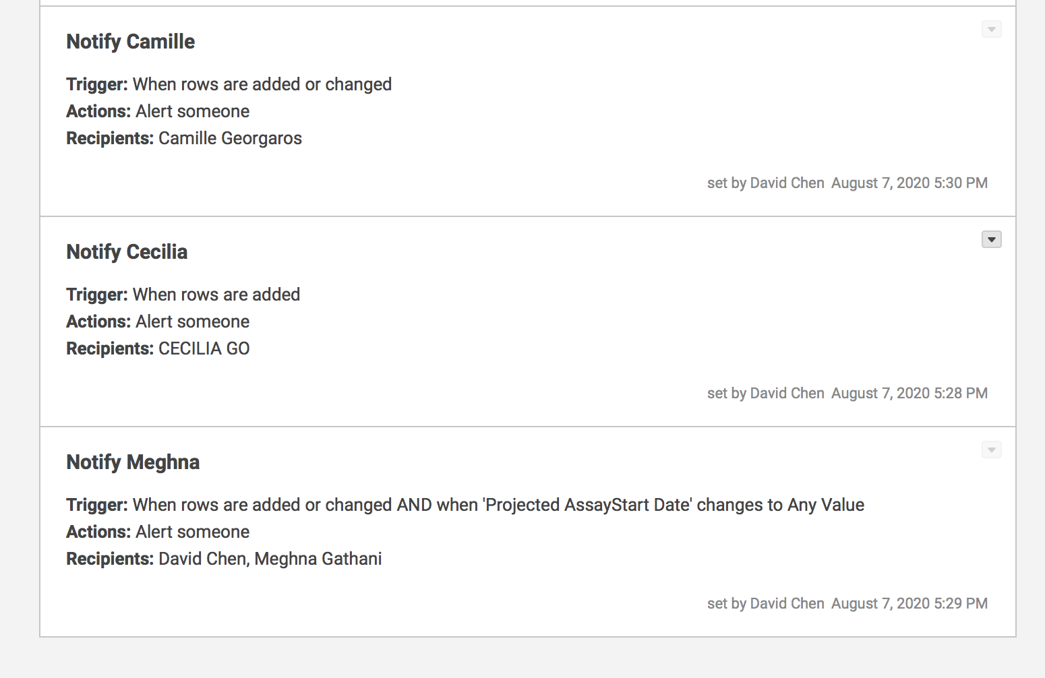
Smartsheet workflows
Smartsheet Workflows: Automated actions that trigger upon certain conditions
Email notifications
Copy Rows to another Smartsheet
Move Rows
Lock / Unlock Rows
Workflow A
Workflow B
ADG Protein Request
Copy row to Production
If < 1g: do A
Email Notification
If any row changes: do B
Figure 4. Automation Workflows

Slide 9
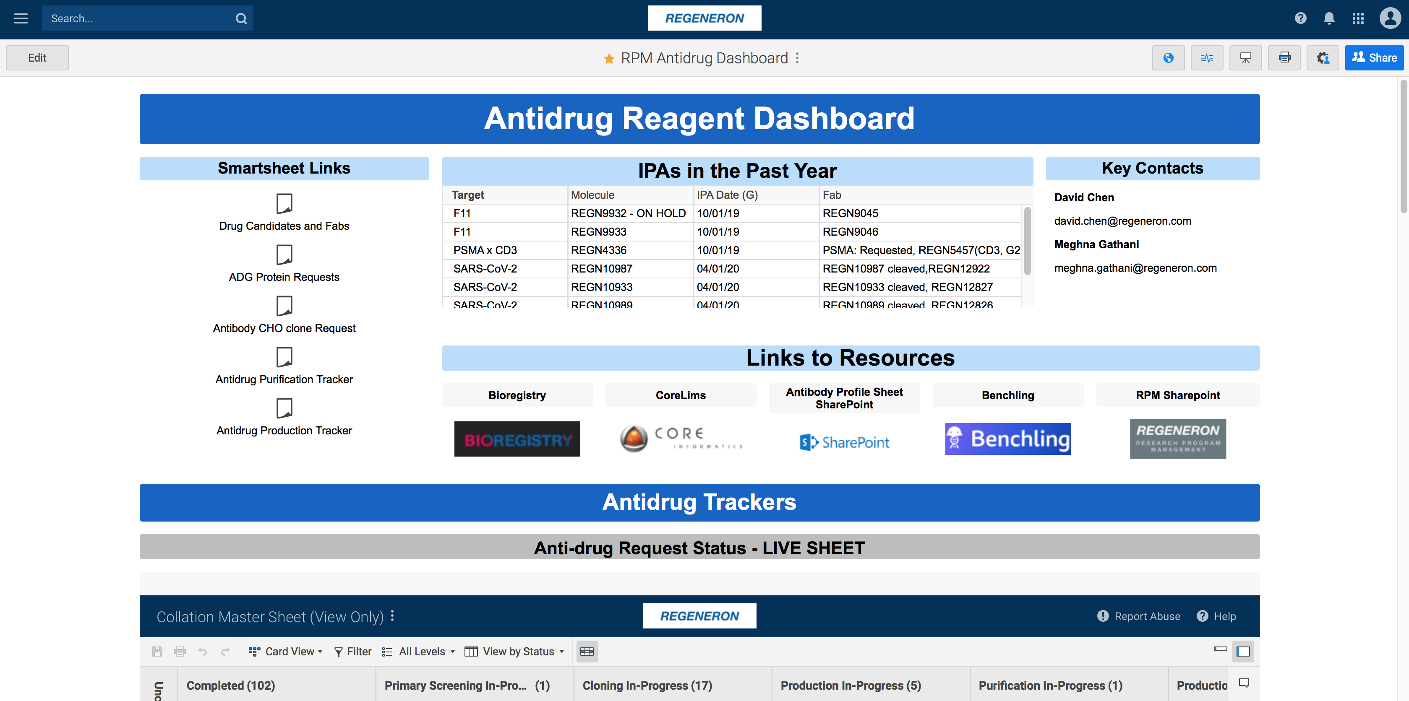
Dashboard design

